Slide 1
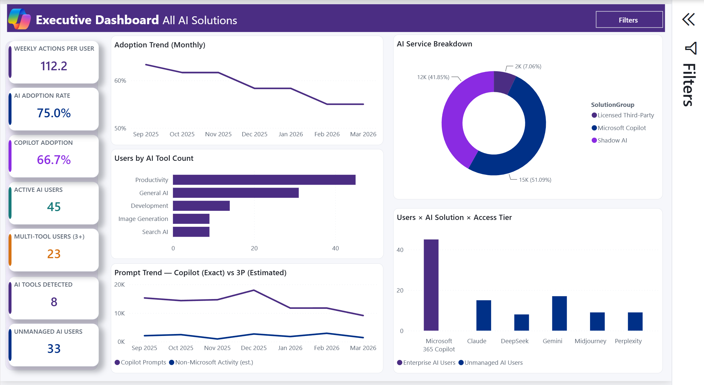
V27 IN TESTING
AI Solutions
Intelligence Dashboard
Interpretation Storyboard
A page-by-page guide to the questions each visual answers, what the signals may mean, and what to verify before acting.
Actual V27 Power BI capture - fabricated sample data
Get the template and documentation at
All figures shown use deterministic fabricated sample data. This experimental template is an analysis aid, not a sole source of truth for licensing, security, privacy, legal, compliance, personnel, or procurement decisions.
github.com/microsoft/AI-Solutions-Intelligence-Dashboard
Last updated September 5, 2026

Slide 2
The four questions that matter
Start here before opening a detail page
1
ADOPTION - Who is using AI, and how broadly?
2
COPILOT VALUE - Which surfaces are gaining traction?
Use active users, workforce adoption, department reach, and weekly activity together. Volume without population context can overstate broad adoption.
Compare licensed users with observed activity by surface and department. Audit-derived prompt metrics are directional and can differ from official usage reports.
3
GOVERNANCE - Which signals warrant review?
4
COVERAGE - What can the available sources support?
Use shadow-tool classifications, consent risk, geo patterns, and file proximity to prioritize investigation. None of these signals proves misuse or data disclosure.
Confirm licenses, onboarding, connectors, permissions, retention, and reporting period before interpreting blanks or comparing values across pages.
Read adoption and governance indicators frequently; revisit locally defined targets and source coverage on a scheduled review cadence.
github.com/microsoft/AI-Solutions-Intelligence-Dashboard
V27 In Testing | Fabricated sample data

Slide 3
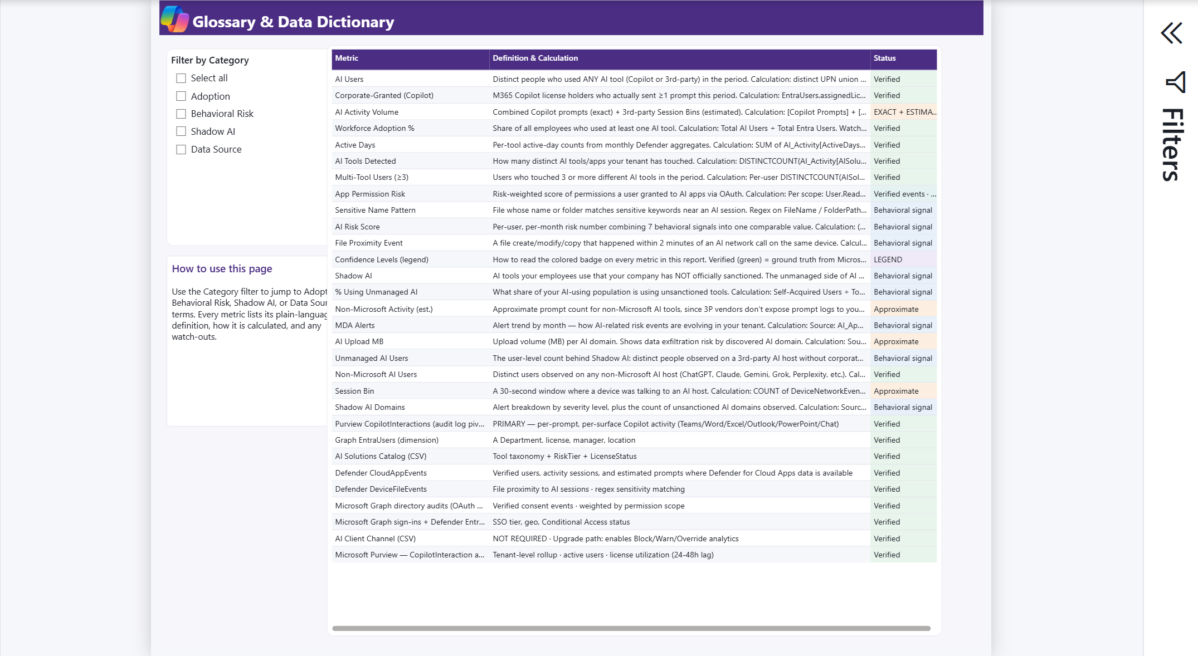
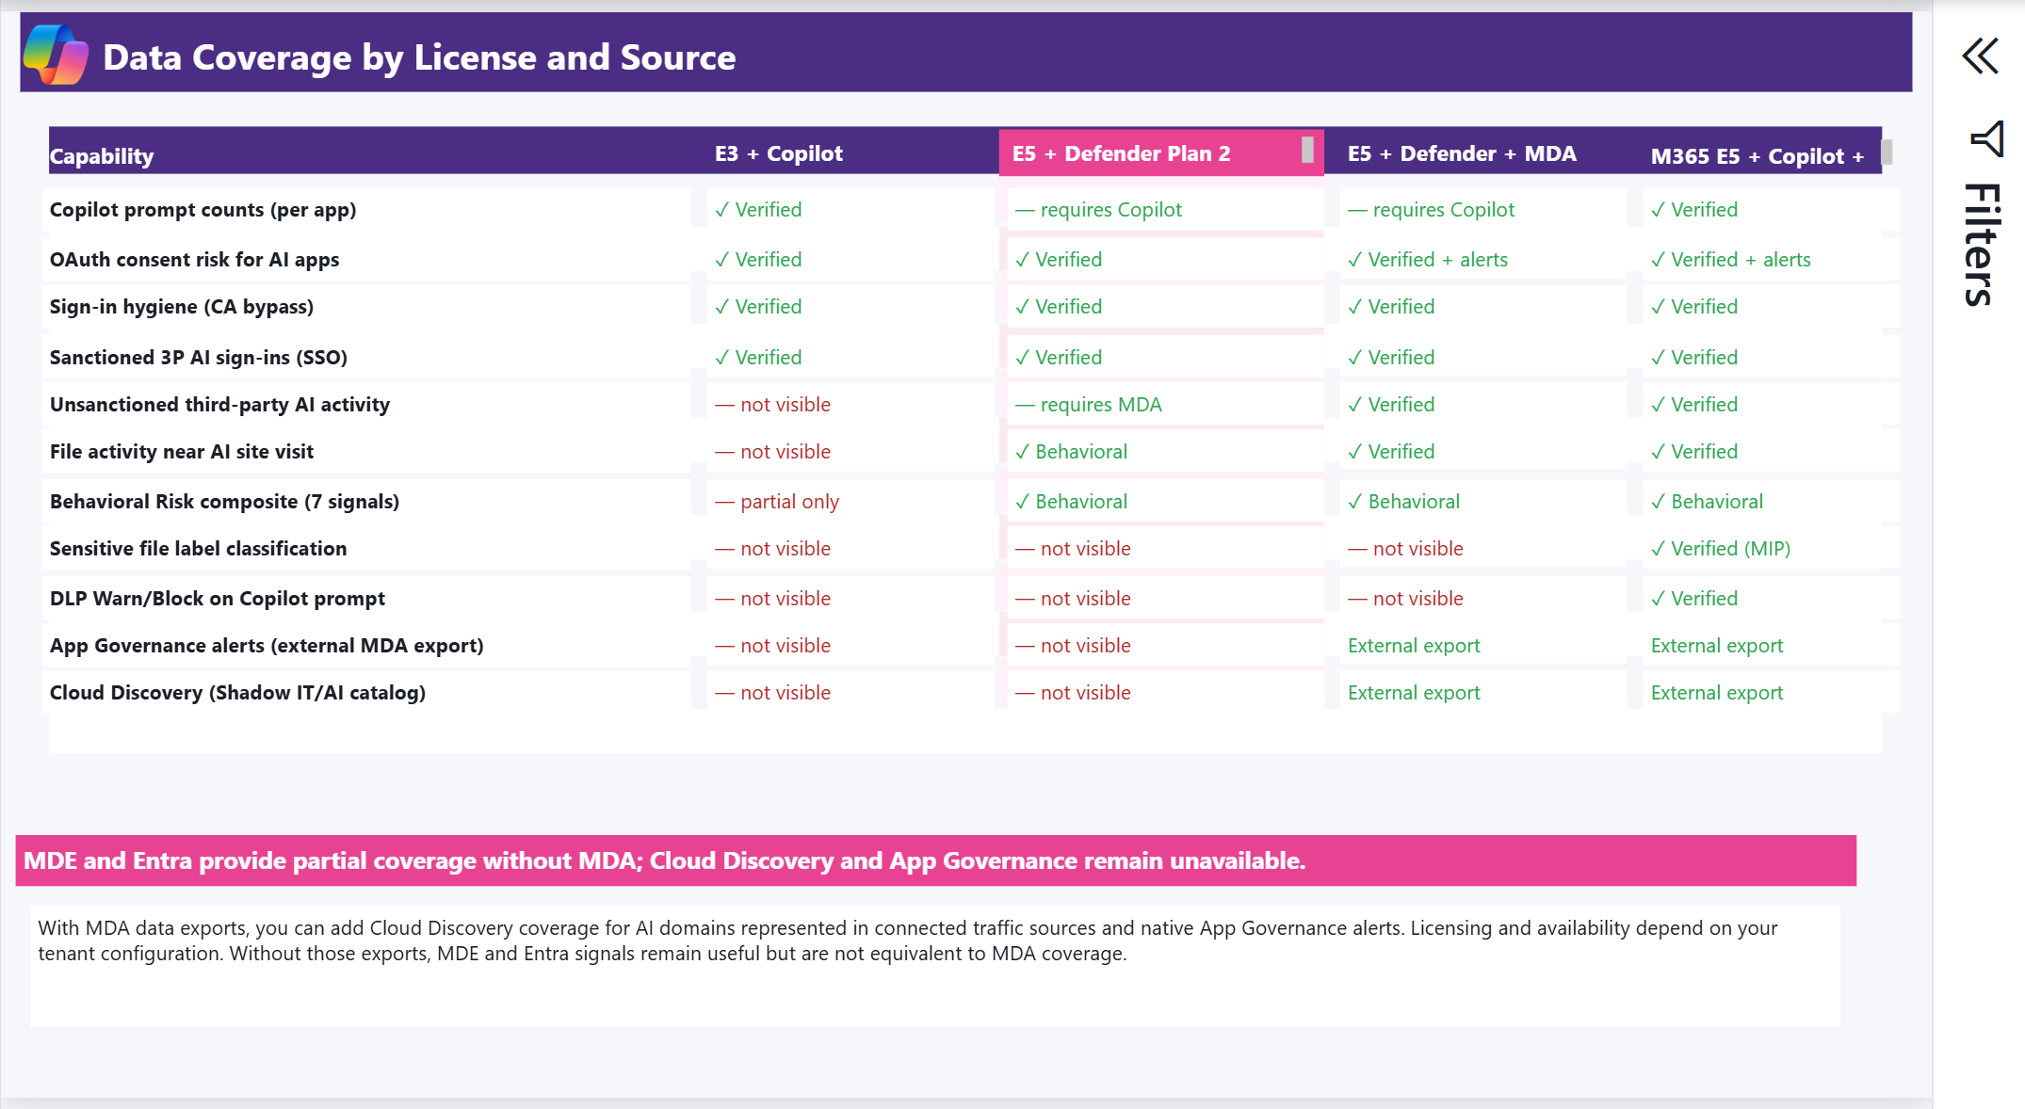
Introduction
What this storyboard is designed to do
This guide walks through the AI Solutions Intelligence Dashboard page by page. Every dashboard page is paired with four business questions, a careful interpretation, and a concrete next action.
Detailed page interpretation
Follow callouts 1 through 4 to read each page in a consistent order. Begin with the question, use the interpretation to understand the limits of the metric, then complete the action before making a decision.
Actual V27 Power BI capture - fabricated sample data
Before quoting any value
Check the active filters, reporting period, source coverage, confidence label, and denominator. Protect exports because they can contain user identifiers and other sensitive operational data.
Actual V27 Power BI capture - fabricated sample data
github.com/microsoft/AI-Solutions-Intelligence-Dashboard
V27 In Testing | Fabricated sample data

Slide 4
Why an observed signal is not proof - and why that matters
Different evidence requires different action
1
2
3
4
OBSERVE
INTERPRET
VERIFY
ACT
The report receives events, dimensions, and locally maintained catalog classifications from configured sources.
Measures summarize, estimate, or combine those records. Some are exact; others are approximations or behavioral signals.
Source records, identity and device context, retention, connectors, and business purpose must be corroborated.
Use organizational incident, privacy, acceptable-use, licensing, procurement, and legal processes.
Examples: file proximity is timing correlation, not proof of upload; AI Upload MB is network volume, not content evidence; a high OAuth permission weight does not prove malicious intent; a catalog label does not independently establish a policy violation.
github.com/microsoft/AI-Solutions-Intelligence-Dashboard
V27 In Testing | Fabricated sample data

Slide 5
How to read this report
Build the narrative from coverage to action
Tier Comparison
Confirm which source systems and capabilities can populate.
Behavioral Risk
Prioritize cross-signal patterns for corroboration.
1
6
Executive Summary
Orient on adoption, tool mix, and monthly direction.
MDA Detail
Add optional App Governance and Cloud Discovery evidence.
2
7
Copilot Deep Dive
Understand Microsoft 365 Copilot surfaces and reach.
Benchmarks & Targets
Compare observations with locally owned assumptions.
3
8
Department Views
Separate broad adoption from concentrated intensity.
Glossary
Confirm definition and confidence before sharing a metric.
4
9
Shadow AI
Review observed third-party tools and local classifications.
5
At every review ask: Is the trend sustained? Is activity broad or concentrated? Which source limitation could change the interpretation? What evidence is required before action?
github.com/microsoft/AI-Solutions-Intelligence-Dashboard
V27 In Testing | Fabricated sample data

Slide 6
Frequently asked questions
The answers to align on before a dashboard review
What is this dashboard?
A Power BI template that combines source-dependent indicators for adoption, third-party AI activity, consent risk, off-hours and geo patterns, and optional MDA data.
Q
Where does the data come from?
From the 13-file CSV contract populated by Graph, Purview, Defender XDR, local catalog data, and optional Defender for Cloud Apps exports.
Q
Why do my numbers look different?
The slides use fabricated demo data. Tenant values depend on source coverage, filter context, reporting period, retention, identity mapping, and catalog choices.
Q
How often should I review it?
Review adoption and risk indicators on an agreed operating cadence. Review targets, ownership, and coverage whenever source or policy assumptions change.
Q
What should I do when a signal looks concerning?
Validate the original source record and business context. Follow established security, privacy, compliance, procurement, and personnel processes.
Q
github.com/microsoft/AI-Solutions-Intelligence-Dashboard
V27 In Testing | Fabricated sample data

Slide 7
Glossary
Definitions to use when presenting the report
AI Users
Workforce Adoption %
Distinct users observed in any configured AI activity source. Limited by available telemetry and identity resolution.
Observed AI users divided by the report workforce denominator. Denominator quality depends on EntraUsers.csv.
Copilot Adoption %
Active Days
Licensed users with observed Copilot activity divided by licensed users. Audit-derived and directional.
Distinct dates with observed activity. Source timestamp and timezone definitions can change the result.
Weekly Actions per User
Non-Microsoft Activity
Observed actions normalized by active users and weeks. An average can hide concentration.
Modeled activity for configured third-party AI tools. It is not an actual prompt count.
github.com/microsoft/AI-Solutions-Intelligence-Dashboard
V27 In Testing | Fabricated sample data

Slide 8
Glossary - continued
Risk, coverage, and planning terms
AI Risk Score
Sensitive Proximity Event
A composite of configured behavioral signals. It is a triage score, not probability, proof, or severity.
A selected file event shortly after an AI-domain connection. Correlation only; not proof of upload.
Geo Anomaly Event
AI Upload MB
A country pattern meeting the model rule. VPN, travel, proxies, and routing can create false positives.
Cloud Discovery network volume attributed to a domain. It does not identify content or prove exfiltration.
Gap vs Target
Confidence Label
Actual minus a locally configured target. The target is an organizational choice, not a Microsoft benchmark.
Verified, exact plus estimated, approximate, or behavioral signal. Use it to calibrate how strongly to state a finding.
github.com/microsoft/AI-Solutions-Intelligence-Dashboard
V27 In Testing | Fabricated sample data

Slide 9
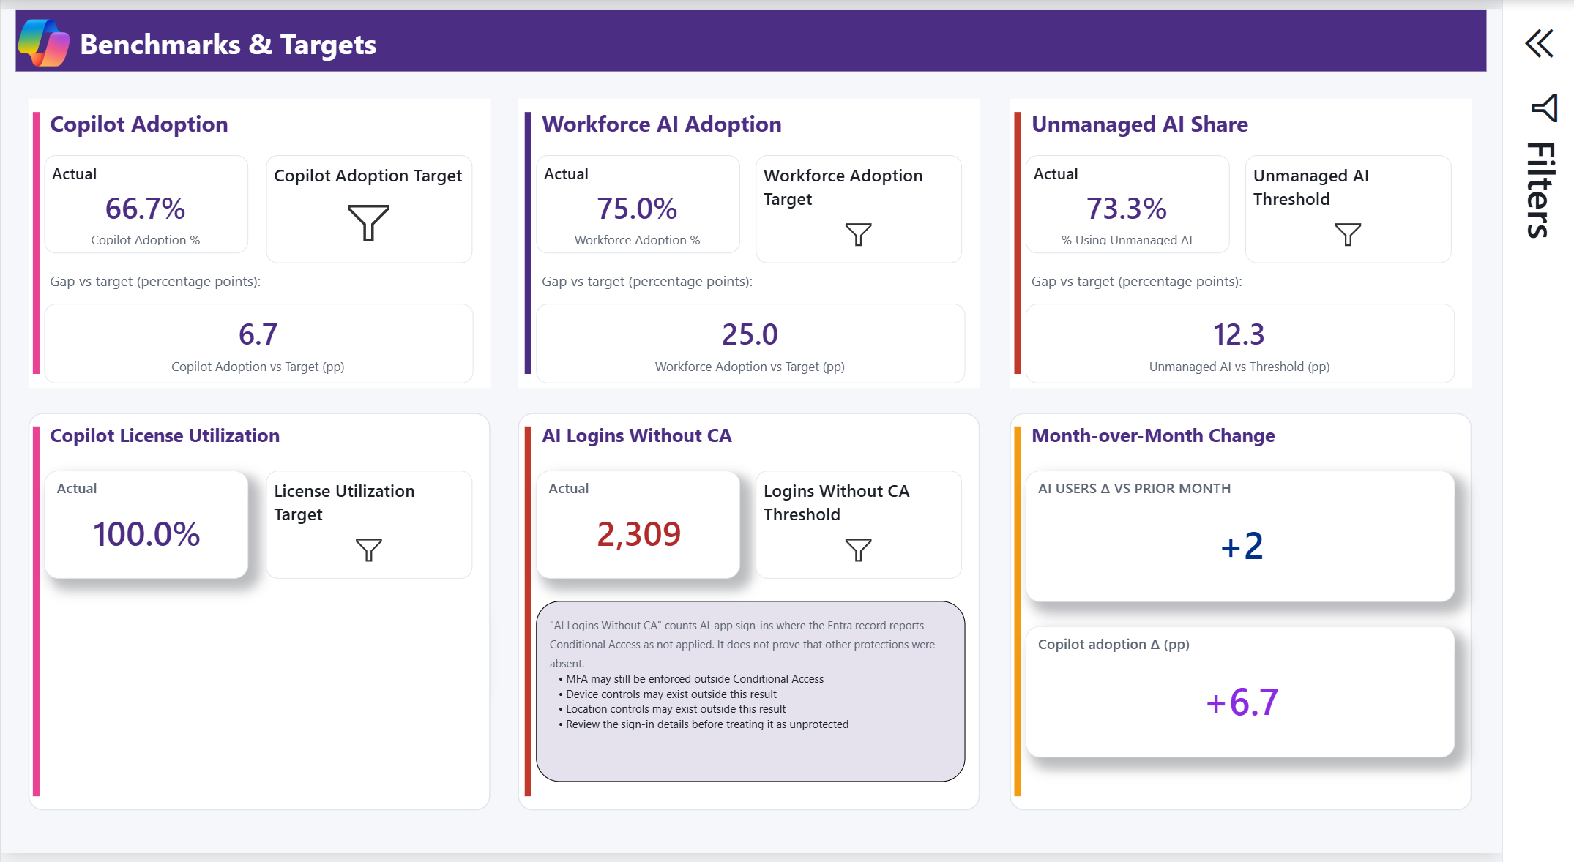
How to use targets responsibly
Targets are local planning assumptions, not Microsoft benchmarks
Signal
Review question
Required caution
Adoption
Is observed reach moving toward the locally owned goal?
Confirm denominator and source coverage.
License utilization
Are licensed users active in the selected period?
No observed activity is not proof of never-used.
Actual V27 Power BI capture - fabricated sample data
Unmanaged AI share
Is locally classified shadow activity changing?
Classification comes from the local catalog.
Target governance
Document the owner, rationale, review cadence, data period, and action threshold for every target. Keep the definition stable when comparing periods.
Logins without CA
Which successful sign-ins did not report CA success?
Other protections may still have applied.
A positive arithmetic gap is not automatically good or bad. Interpret whether higher or lower is desirable for that metric.
github.com/microsoft/AI-Solutions-Intelligence-Dashboard
V27 In Testing | Fabricated sample data

Slide 10
Your first 30 days with this report
A practical sequence before operational use
WEEK 1
WEEK 2
WEEK 3
WEEK 4
Confirm the data
Align definitions
Corroborate signals
Run the review
Load the 13 CSVs. Check filters, reporting period, source freshness, row counts, identity mappings, and Tier Comparison. Do not present findings yet.
Review the glossary and confidence labels. Confirm catalog classifications, workforce denominator, target owners, and locally accepted terms.
Select representative adoption and risk patterns. Trace them back to source records and document false-positive or coverage scenarios.
Open with the Executive Summary, state coverage and limitations, then move to the relevant detail pages and agreed next actions.
github.com/microsoft/AI-Solutions-Intelligence-Dashboard
V27 In Testing | Fabricated sample data

Slide 11
Detailed page interpretation
Ten dashboard pages | four questions each | one evidence-aware reading path
START WITH 1

Slide 12
Executive Summary
Portfolio-level adoption, tool mix, and monthly direction
1
Is observed AI adoption broad or concentrated?
INTERPRETATION
AI Users and workforce adoption show reach within the configured sources and current filters. They are not a complete inventory of every AI interaction.
ACTION
Confirm the workforce denominator, active month, and source coverage before quoting the adoption rate.
2
Which solution groups are driving activity?
INTERPRETATION
The service breakdown separates Copilot, licensed third-party, and shadow classifications using the local catalog and observed activity.
ACTION
Validate catalog classifications and compare user counts with volume before drawing a governance conclusion.
Actual V27 Power BI capture - fabricated sample data
3
Is the direction sustained across periods?
4
Where should the review go next?
INTERPRETATION
Monthly trends show available report periods. Non-Microsoft prompt figures are modeled from activity/session signals rather than vendor logs.
INTERPRETATION
This page orients the conversation but does not explain surface adoption, department concentration, or individual risk signals.
ACTION
Use several complete periods and check filters; do not infer a trend from one partial month.
ACTION
Continue to Copilot Deep Dive, Shadow AI, and Department Breakdown for the relevant evidence.
github.com/microsoft/AI-Solutions-Intelligence-Dashboard
V27 In Testing | Fabricated sample data

Slide 13
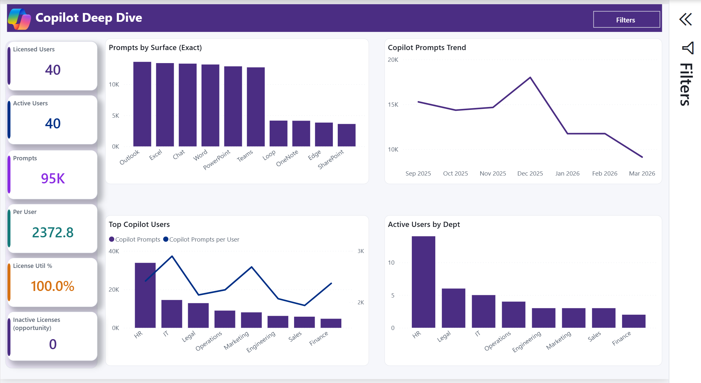
Copilot Deep Dive
Audit-event-derived activity by surface, user, month, and department
1
Are licensed and active users telling the same story?
INTERPRETATION
Licensed Users is an entitlement dimension. Active Users requires observed activity in the selected context; the two values answer different questions.
ACTION
Review the reporting period and official Microsoft 365 Copilot usage report before a license action.
2
Which Copilot surfaces are gaining traction?
INTERPRETATION
Prompt counts come from Purview CopilotInteraction audit records and retain the reported surface. They are directional analysis metrics.
ACTION
Compare surface mix over time and use the pattern to target workload-specific enablement.
Actual V27 Power BI capture - fabricated sample data
3
Is activity broad or driven by a small group?
4
What can this page support operationally?
INTERPRETATION
Prompts per user and department bars can look strong when a small population is highly active. Averages can hide concentration.
INTERPRETATION
It can surface enablement and adoption patterns, but audit-derived metrics can differ from official product usage reports.
ACTION
Read active-user counts with prompt volume and inspect department reach before scaling conclusions.
ACTION
Use official usage reporting as the product benchmark and this page for cross-source context.
github.com/microsoft/AI-Solutions-Intelligence-Dashboard
V27 In Testing | Fabricated sample data

Slide 14
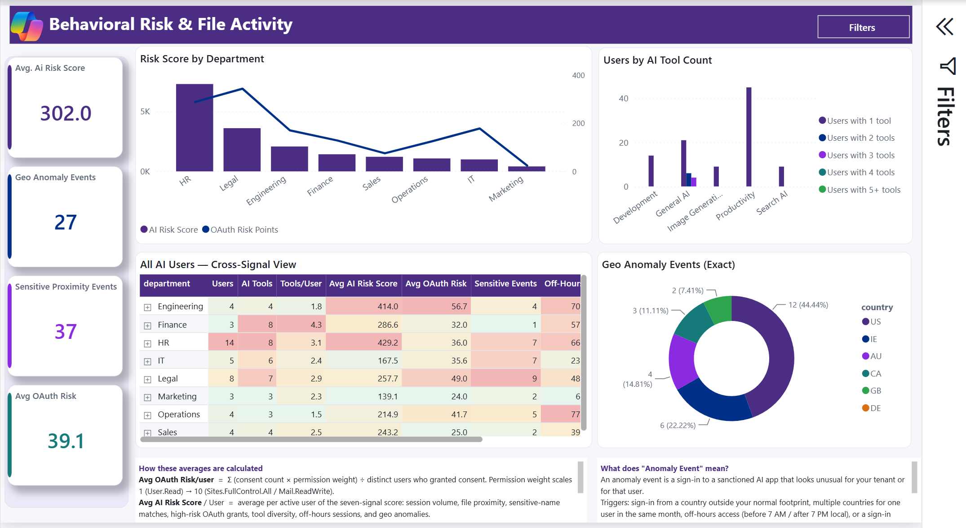
Behavioral Risk and File Activity
Cross-signal triage for investigation priority
1
What does the AI Risk Score actually mean?
INTERPRETATION
The score is a composite heuristic built from configured signals. It is not a probability, severity rating, or determination of misconduct.
ACTION
Read each heatmap column independently, then inspect the contributing events and source quality.
2
Do sensitive proximity events prove an upload?
INTERPRETATION
They are selected file events observed shortly after an AI-domain connection. Temporal proximity does not establish transfer, disclosure, or causation.
ACTION
Validate the original file, device, network, and destination evidence before escalation.
Actual V27 Power BI capture - fabricated sample data
3
How should geo anomalies be interpreted?
4
What is the defensible investigation path?
INTERPRETATION
Country patterns can reflect travel, VPNs, proxies, mobile carriers, or shared infrastructure as well as activity that warrants review.
INTERPRETATION
Risk, consent, file, and geo signals prioritize attention but remain incomplete without the underlying source records and business purpose.
ACTION
Confirm identity, sign-in, device, and network context; document likely false-positive conditions.
ACTION
Follow established incident, privacy, acceptable-use, legal, and personnel processes.
github.com/microsoft/AI-Solutions-Intelligence-Dashboard
V27 In Testing | Fabricated sample data

Slide 15
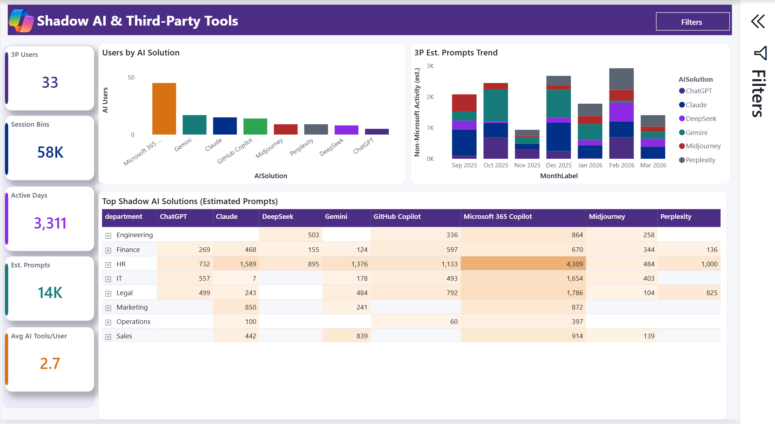
Shadow AI and Third-Party Tools
Observed activity and local sanction classification
1
Why is a tool labeled shadow AI?
INTERPRETATION
The label comes from the corresponding row in ai_solutions_catalog.csv. The report does not independently prove that the tool violates policy.
ACTION
Have security, legal, privacy, procurement, and business owners confirm classifications.
2
Are session bins and estimated prompts exact?
INTERPRETATION
They approximate activity from configured telemetry. They are not content inspection and are not equivalent to vendor prompt logs.
ACTION
Use them for directional comparison, not precise productivity or data-loss claims.
Actual V27 Power BI capture - fabricated sample data
3
Where is unmanaged activity concentrated?
4
What response is proportionate?
INTERPRETATION
The eight starter-solution colors support cross-page tracing; custom catalog additions use the default palette unless explicitly formatted.
INTERPRETATION
Popular tools may need sanctioning review, procurement, user guidance, a supported alternative, or technical control evaluation.
ACTION
Compare values within a column, then check users, departments, and periods before choosing an intervention.
ACTION
Validate domains and purpose first, then use the organization's governance process.
github.com/microsoft/AI-Solutions-Intelligence-Dashboard
V27 In Testing | Fabricated sample data

Slide 16
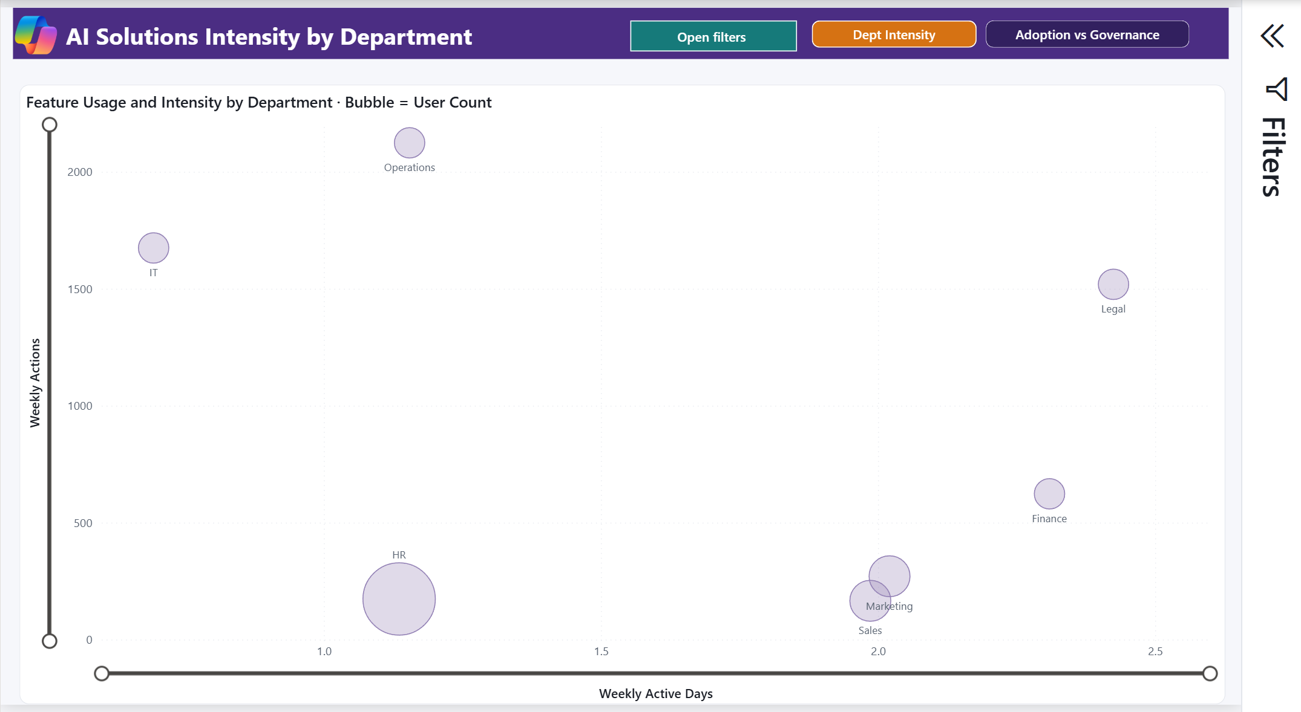
AI Solutions Intensity by Department
Two views of adoption breadth, intensity, and governance
1
Which view should I use?
INTERPRETATION
Dept Intensity compares weekly active days with weekly actions. Adoption vs Governance compares weekly actions per user with the managed-session share.
ACTION
Confirm the orange selected view, then use Open filters. Selections remain applied when the panel closes or the view changes.
2
What does bubble size add?
INTERPRETATION
Bubble size changes by view: Dept Intensity uses AI Users; Adoption vs Governance uses Sensitive Proximity Events.
ACTION
Treat risk-event size as a triage signal, not severity or proof, and corroborate the source events.
Actual V27 Power BI capture - fabricated sample data
3
Which pattern is an enablement opportunity?
4
What should follow the visual comparison?
INTERPRETATION
In Dept Intensity, a large moderate-intensity bubble can indicate broad adoption; a small high-intensity bubble may be a specialist team.
INTERPRETATION
The scatter plot identifies contrast but does not explain which tools or users create it.
ACTION
Validate department population and tool mix, then select the department for detail.
ACTION
Open Department Breakdown and confirm actions, users, solutions, and local business context.
github.com/microsoft/AI-Solutions-Intelligence-Dashboard
V27 In Testing | Fabricated sample data

Slide 17
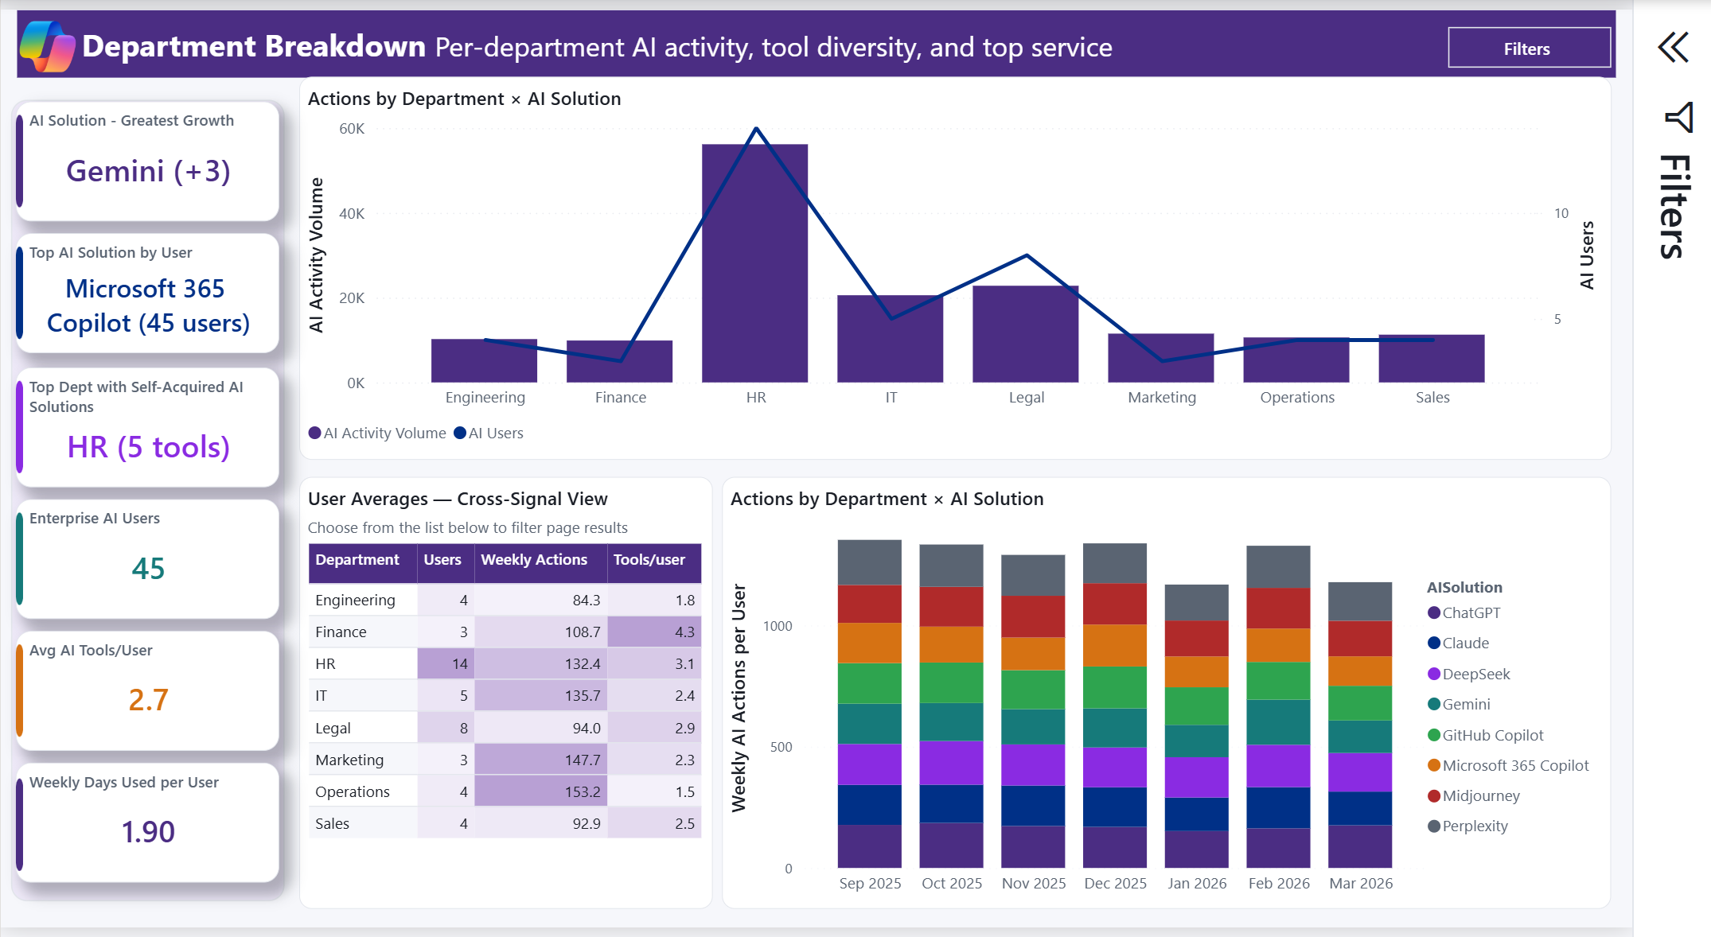
Department Breakdown
Per-department activity, tool diversity, and top services
1
Is high activity broad or concentrated?
INTERPRETATION
A high action count can come from only a few users. User reach and volume must be read together.
ACTION
Compare action volume, active users, and weekly actions per user before ranking departments.
2
Does greatest growth predict future adoption?
INTERPRETATION
Greatest Growth is a period-over-period result in the current filter context. It is not a forecast.
ACTION
Check period completeness and repeat the comparison over several stable windows.
Actual V27 Power BI capture - fabricated sample data
3
Where might tool sprawl be increasing?
4
How should a department action be chosen?
INTERPRETATION
The eight starter-solution colors support cross-page tracing; purple table fills show relative values independently within each metric column.
INTERPRETATION
The page can support enablement or governance hypotheses but cannot supply the department's business purpose.
ACTION
Validate classifications, department mappings, and the users behind each value before comparing departments.
ACTION
Review the pattern with business owners before training, licensing, blocking, or procurement action.
github.com/microsoft/AI-Solutions-Intelligence-Dashboard
V27 In Testing | Fabricated sample data

Slide 18
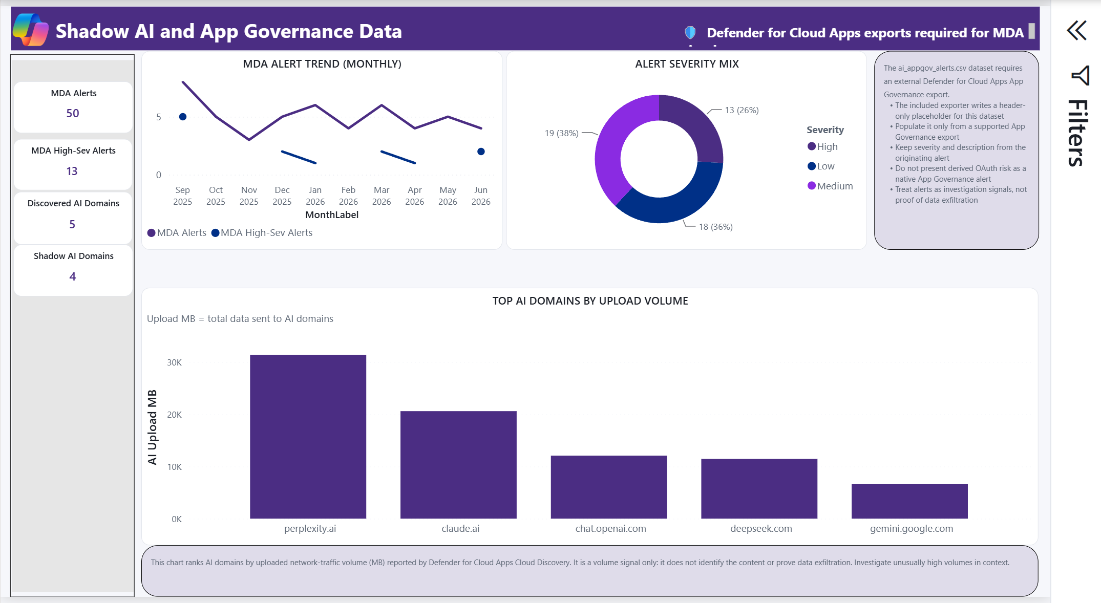
Shadow AI and App Governance Data
Optional Defender for Cloud Apps evidence
1
What source coverage does this page require?
INTERPRETATION
App Governance alerts and Cloud Discovery traffic require supported Defender for Cloud Apps data, connectors, permissions, and retention.
ACTION
Confirm Tier Comparison and connector scope before interpreting an empty visual.
2
How should alert severity be handled?
INTERPRETATION
Severity and descriptions should remain those supplied by the originating alert. The report does not create a new severity determination.
ACTION
Open the source alert and follow the source-system investigation workflow.
Actual V27 Power BI capture - fabricated sample data
3
Does AI Upload MB prove exfiltration?
4
Why might this page be blank?
INTERPRETATION
It is network traffic volume attributed by Cloud Discovery. It does not identify transferred content or establish data loss.
INTERPRETATION
Missing data can reflect licensing, region, unconfigured connectors, retention, export scope, or header-only placeholder files.
ACTION
Investigate the underlying session, user, device, destination, and content evidence.
ACTION
Resolve source availability before concluding that no relevant activity or alerts exist.
github.com/microsoft/AI-Solutions-Intelligence-Dashboard
V27 In Testing | Fabricated sample data

Slide 19
Benchmarks and Targets
Observed metrics against locally selected what-if assumptions
1
Are these Microsoft benchmarks?
INTERPRETATION
No. The target controls are user-entered planning assumptions chosen by the organization.
ACTION
Document each target's owner, rationale, review cadence, and action threshold.
2
Is a positive gap always favorable?
INTERPRETATION
Gap cards are arithmetic differences in percentage points or counts. Desired direction depends on the metric.
ACTION
State whether higher or lower is desirable before presenting the gap.
Actual V27 Power BI capture - fabricated sample data
3
What does logins without CA mean?
4
Can month-over-month cards be quoted immediately?
INTERPRETATION
It counts successful AI sign-ins whose Entra record does not report Conditional Access as successfully applied. Other protections may still exist.
INTERPRETATION
They compare the current report period with the prior period available to the measure. A partial month can distort the change.
ACTION
Inspect the source sign-in and relevant controls before asserting an access-control failure.
ACTION
Check filter context and period completeness, then use the same definition each review.
github.com/microsoft/AI-Solutions-Intelligence-Dashboard
V27 In Testing | Fabricated sample data

Slide 20
Glossary and Data Dictionary
Definitions, source descriptions, and confidence labels
1
What does Verified mean?
INTERPRETATION
Verified means calculated from a named source event or dimension. It does not establish intent, causality, or complete tenant coverage.
ACTION
Pair the metric with its source, reporting period, and relevant limitations.
2
How should estimated metrics be stated?
INTERPRETATION
Exact plus estimated mixes source values with modeled activity. Status colors reinforce the visible labels; they do not replace them.
ACTION
Use the confidence label in screenshots, exports, and executive narration.
Actual V27 Power BI capture - fabricated sample data
3
Why review source-table definitions?
4
When should this page be opened?
INTERPRETATION
They describe the report input and calculation path, not guaranteed source availability or completeness in a tenant.
INTERPRETATION
Use it whenever a metric will be repeated outside the report or compared across audiences.
ACTION
Trace unexpected values back to the CSV, collector, and originating system.
ACTION
Confirm definition, confidence, period, filters, and denominator before sharing.
github.com/microsoft/AI-Solutions-Intelligence-Dashboard
V27 In Testing | Fabricated sample data

Slide 21
Data Coverage by License and Source
Planning aid for available signals and known limitations
1
Is this matrix a licensing entitlement statement?
INTERPRETATION
No. It is a planning aid that maps report capabilities to common product and source combinations.
ACTION
Verify current Microsoft licensing documentation and tenant configuration.
2
Why can an owned product still produce no data?
INTERPRETATION
Onboarding, connector selection, permissions, region, policy configuration, export scope, and retention all affect coverage.
ACTION
Validate each dependency before interpreting an empty page as no activity.
Actual V27 Power BI capture - fabricated sample data
3
What does the sign-in hunting signal require?
4
What does CloudAppEvents require?
INTERPRETATION
EntraIdSignInEvents requires Microsoft Entra ID P2 and appropriate Defender XDR advanced hunting access.
INTERPRETATION
CloudAppEvents requires Defender for Cloud Apps data and its Microsoft 365 activities connector; MDE Plan 2 alone does not supply the table.
ACTION
Confirm role, license, and table availability in the target tenant.
ACTION
Resolve missing source coverage before drawing conclusions from MDA-dependent visuals.
github.com/microsoft/AI-Solutions-Intelligence-Dashboard
V27 In Testing | Fabricated sample data

